Slide 1
ECE 471/571 - Lecture 17
Stochastic Methods
10/11/13

Slide 2
General Approach to Learning
Optimization methods
  Newton’s method
  Gradient descent
  Exhaustive search through the solution space
  For more complex models
    Boltzmann learning
    Genetic algorithms
Objective functions
  Maximum a-posteriori probability
  Maximum likelihood estimate
  Fisher’s linear discriminant
  Principal component analysis
  k-nearest neighbor
  Perceptron
  Back propagation neural network
  Hopfield network

Slide 3
Local and Global Optimum
Gradient descent vs. simulated annealing
(local minima) vs. (global minimum)
Applications
  BP
    Local optima
  Hopfield network
    Local optima
  Boltzmann network
    Global optimum

Slide 4
General Approach to Learning
Specify a model (objective function) and estimate its parameters
Use optimization methods to find the parameters
  1st derivative = 0
  Gradient descent
  Exhaustive search through the solution space
  For more complex models
    Boltzmann learning
    Genetic algorithms

Slide 5
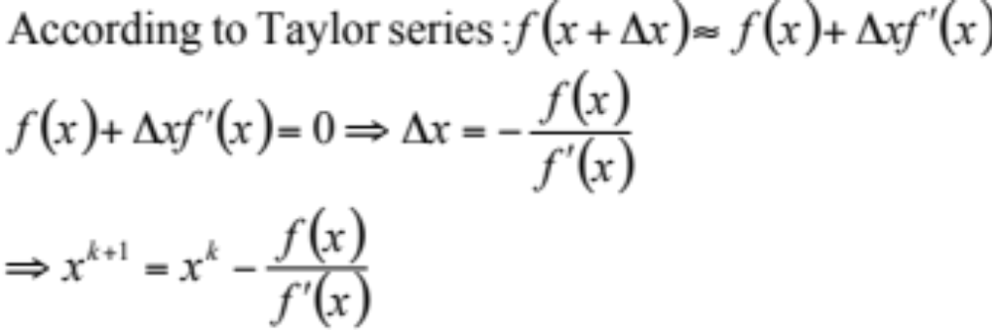
Newton-Raphson Method
Used to find solution to equations

Slide 6
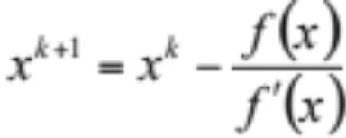
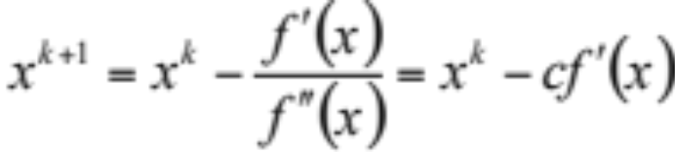
Newton-Raphson Method vs. Gradient Descent
f(x) = x² – 5x – 4
f(x) = xcosx
Newton-Raphson method
Used to find solution to equations
  Find x for f(x) = 0
The approach
  Step 1: select initial x0
  Step 2:
  Step 3: if |x^{k+1} – x^{k}| < ε, then stop; else x^{k} = x^{k+1} and go back step 2.
Gradient descent
Used to find optima, i.e. solutions to derivatives
  Find x* such that f(x*) < f(x)
The approach
  Step 1: select initial x0
  Step 2:
  Step 3: if |x^{k+1} – x^{k}| < ε, then stop; else x^{k} = x^{k+1} and go back step 2.

Slide 7
% [x] = gd(x0, c, epsilon)
% - Demonstrate gradient descent
% - x0: the initial x
% - c: the learning rate
% - epsilon: controls the accuracy of the solution
% - x: an array tracks x in each iteration
%
% Note: try c = 0.1, 0.2, 1; epsilon = 0.01, 0.1
function [x] = gd(x0, c, epsilon)
% plot the curve
clf; fx = -10:0.1:10; [fy, dfy] = g(fx); plot(fx, fy); hold on;
% find the minimum
x(1) = x0; finish = 0; i = 1;
while ~finish
[y, dy] = g(x(i));
plot(x(i), y, 'r*'); pause
x(i+1) = x(i) - c * dy;
if abs(x(i+1)-x(i)) < epsilon
finish = 1;
end
i = i + 1;
end
x(i)
% plot trial points
[y, dy] = g(x);
for i=1:length(x)
plot(x(i), y(i), 'r*');
end
function [y, dy] = g(x)
y = 50*sin(x) + x .* x ;
dy = 50*cos(x) + 2*x;

Slide 8
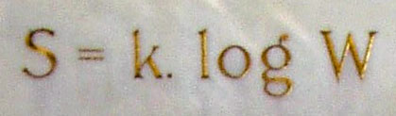
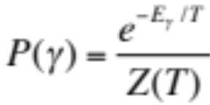
Approaches for Complex Model
Boltzmann factor
Boltzmann learning
  Based on concepts and techniques in physics, especially in statistical mechanics
Genetic algorithm
  Based on concepts from biology, specifically the mathematical theory of evolution
High computational burden

Slide 9
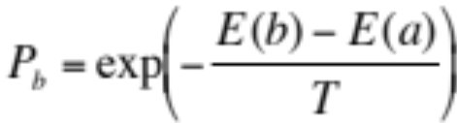
Simulated Annealing
Choose an initial value of a, and an initial value of the temperature (should be high)
Step 1: Generate a point b which is a neighbor of a
Step 2: If E(b) < E(a) then replace a with b
Step 3: Else compute Pb. If Pb > R, then replace a with b, where R is a random number uniformly distributed between 0 and 1
Step 4: Decrease T slightly and goto step 1.

Slide 10
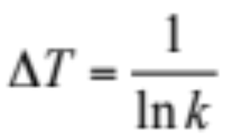
Parameter Setting
How to decrease T
How to choose the neighbor of a?
  Suppose a is binary, then change one element of a

Slide 11
How Does SA Work?
In step 2, we perform a descent. That is, always “fall down hill”
In step 3, we provide a mechanism for sometimes making uphill moves.
  The likelihood of an uphill move is strongly influenced by T
    Initially, T is very big, always accept uphill moves
    As T is gradually reduced, uphill moves become gradually less likely until for low values of T, when such moves are essentially impossible
  Exponentially less likely to occur as the size of the uphill move becomes larger

Slide 12
**Mean Field Annealing
SA is a random process
SA has been proven to converge to a global minimum under special conditions, but very slow
MFA is an approximation to SA. It replaces random search with a series of deterministic gradient descents
S. Kirkpatrick, C. D. Gelatt, Jr., M. P. Vecchi, “Optimization by simulated annealing.” Science, 220(4598):671-678, 13 May 1983.

Slide 13





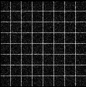
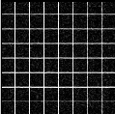

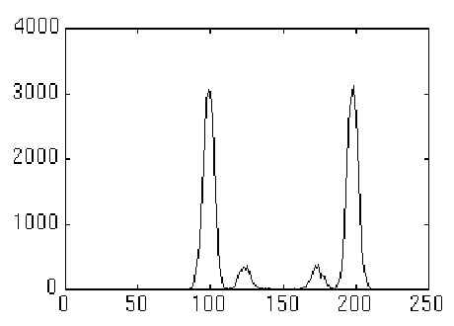
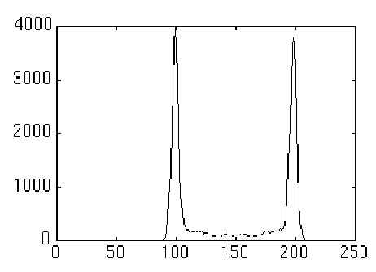
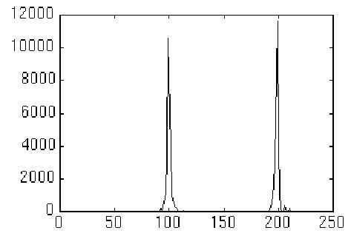
**Application Example – Image Restoration

Slide 14
Genetic Algorithms

Slide 15
Roots
Based on concepts from biology, especially evolution (natural selection and genetics)
Variables are represented as genes on a chromosome
GAs feature a group of candidate solutions (population) on the response surface. Through natural selection and the genetic operators, mutation and recombination, chromosomes with better fitness are found.

Slide 16
How Does It Work?
Natural selection guarantees that chromosomes with the best fitness will propagate in future populations.
Using the recombination operator, the GA combines genes from two parent chromosomes to form two new chromosomes (children) that have a high probability of having better fitness than their parents.
Mutation allows new areas of the response surface to be explored.
GAs offer a generational improvement in the fitness of the chromosomes and after many generations will create chromosomes containing the optimized variable settings.

Slide 17
Pros and Cons
Pros
  Require no knowledge or gradient information about the response surface
  Discontinuities present on the response surface have little effect on overall optimization performance
  Resistant to becoming trapped in local optima
  Perform very well for large-scale optimization problems
  Can be employed for a wide variety of optimization problems
Cons
  Have trouble finding the exact global optimum
  Require large number of response (fitness) function evaluations
  Configuration is not straightforward

Slide 18
Initialization
Generates the initial population
E.g. different routes in travelling salesman problem (TSP)
http://www.obitko.com/tutorials/genetic-algorithms/tsp-example.php

Slide 19
Evaluation
Use the fitness function to evaluate each chromosome
Goal: numerically encode the performance of each chromosome
E.g. minimum distance

Slide 20
Natural Selection
The chromosomes with the largest fitness scores are placed one or more times into a mating subset in a semi-random fashion.
Chromosomes with low fitness scores are removed from the population.
Binary tournament mating subset selection
  Each chromosome in the population competes for a position in the mating subset
  Two chromosomes are drawn at random from the population, the chromosome with the highest fitness score is placed in the mating subset
  Both chromosomes are returned to the population and another tournament begins
  This procedure continues until the mating subset is full.
  A characteristic of this scheme is that the worst chromosome in the population will never be selected for inclusion in the mating subset.

Slide 21
Exploration
Consists of the recombination and mutation operators
  A mutation simply changes the value for a particular gene.
Two chromosomes (parents) from the mating subset are randomly selected to be mated. The probability that these chromosomes are recombined (mated) is a user-controlled option and is usually set to a high value (e.g., 0.95).

Slide 22
Exploitation - Recombination
If the parents are allowed to mate, a recombination operator is employed to exchange genes between the two parents to produce two children.
If they are not allowed to mate, the parents are placed into the next generation unchanged.
Recombination operators
  One-point method: a crossover point is selected along the chromosome and the genes up to that point are swapped between the two parents.
  Two-point method: two crossover points are selected and the genes between the two points are swapped. The children then replace the parents in the next generation.

Slide 23
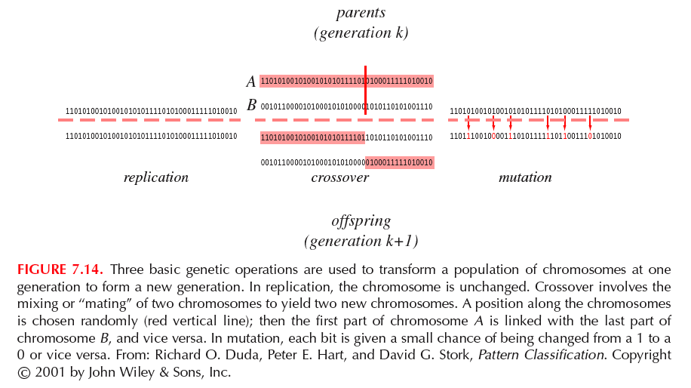

Slide 24
Block Diagram
Initialization
Evaluation using
Fitness function
Natural selection
Exploration
(recombination and mutation)

